Slide 1
Project notes

Slide 2
New deadline
Tuesday 7th before lecture
Interviews to follow, before 18th
Marks by/before 18th
Implement as much as you can, but be sure to explain your design even if the code is incomplete or has bugs

Slide 3
Question changes
Drop partial synchrony
If you already did any work on this that you want to keep, please include it in the report
Drop 2nd solution to Q1
again if done already please include
Some code extracts and hints to follow…

Slide 4
Errata
Sometimes the book is wrong
http://distributedprogramming.net/errata.shtml
Check if you have doubts about your algo
For instance, tob has small mistakes on message and sender storage

Slide 5
FIFO order point-to-point
See “Algorithm 2.11: Sequence Number” in chapter 2 page 69
Holdback queue + sequence number
Useful idea for total-order broadcast (later…)

Slide 6
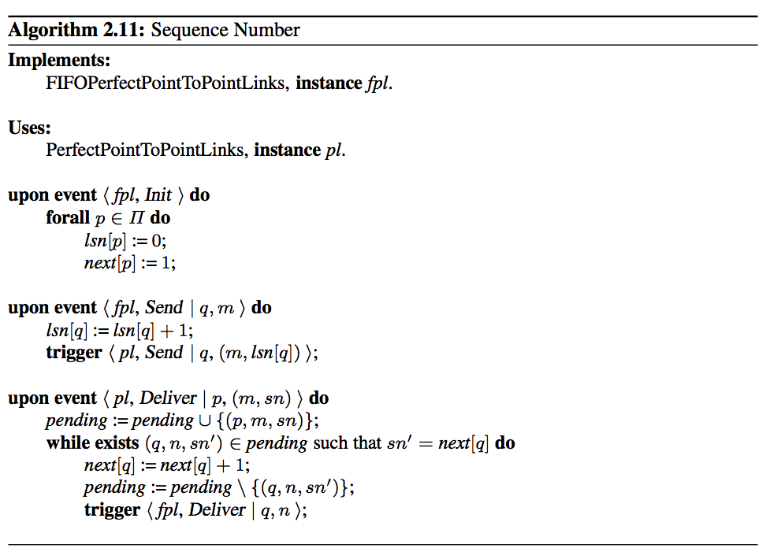

Slide 7
Node identity
node() returns the current node address
stack:nodes() returns all nodes including yourself, in a deterministically sorted order
Crashed nodes are not removed

Slide 8
Node Rank
stack:rank(Node) returns the integer position of Node in stack:nodes()
Useful for hierarchical consensus, leader election, ..?

Slide 9
Condition checking
upon X^Y do
…
Stack doesn’t have this, so add it explicitly.
Write function(s) to check condition & run code
Use them in the program where that state can change (or everywhere, if in doubt).

Slide 10
Condition checking
upon_event({p, crash, PCrashed}, AllState) ->
AllState2 = AllState#state{
detectedranks = sets:add_element(
rank(PCrashed), AllState#state.detectedranks
)
},
check_round_condition_all_instances(AllState2);
run on updated state to produce updated state’

Slide 11
Another option
Wrapper function which calls the checks after message handling:
Have an upon_event function which matches everything, calls another upon_event_ to do the real work, then runs the checks
Less efficient than picking the right places (collection searches) but reach correct behaviour more quickly

Slide 12
Consensus instances
Have added stack:add_component(Module, Instance)
But don’t recommend using it
Race conditions and missed messages unless synchronised creation (we don’t have a barrier sync abstraction)
Instead, k/v store holding instance states
next slide

Slide 13
Lazy-init consensus instance state
% shared state
-record(state, {instances, detectedranks}
).
% instance state
-record(instance,
{instance, round, proposal, proposer, delivered, broadcast}
).
get_instance_state(Instance, AllState) ->
case orddict:find(Instance, AllState#state.instances) of
{ok, Val} -> % existing instance data found
Val;
_ ->
% initial state for new consensus instance
#instance{
instance = Instance, round = 1,
proposal = bottom, proposer = 0,
delivered = orddict:new(), broadcast = false
}
end.

Slide 14
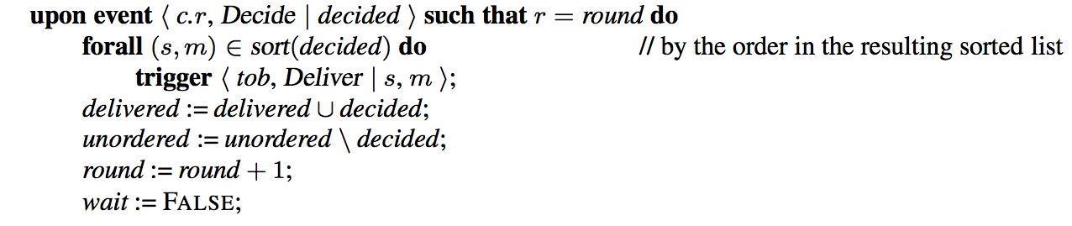
Total-order broadcast (Hierarchical consensus) bug
What happens if leader races ahead?
Solution: as for FIFO PL, holdback queue for decisions, and retry delivery upon receipt
Catch: Robots will receive many steps at once; see extension task
Notes:
one leader deciding and broadcasting decisions

